Slide 1
Natural Language Processing
Unlocking the Power of Human Language !

Slide 2


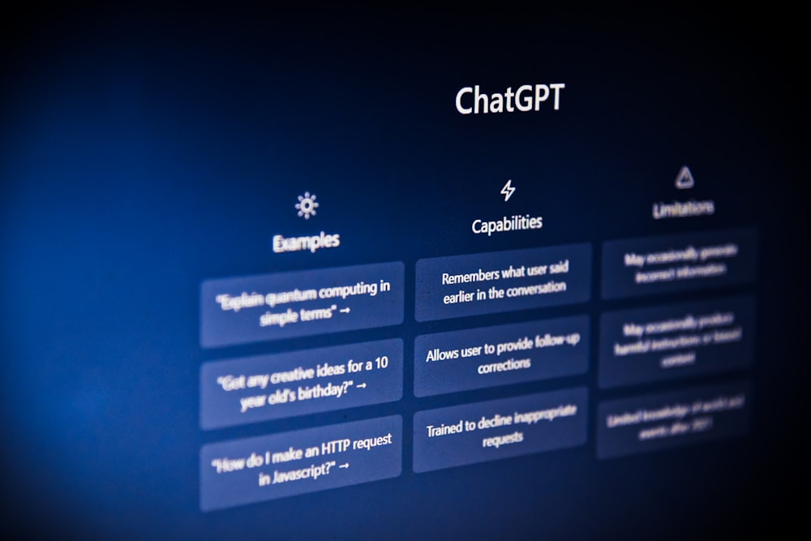
Introduction
Virtual assistants
Chatbots
LLM Models

Slide 3
ALL The Previous Are NLP Examples !
Let’s Explore The NLP World

Slide 4

What IS NLP?
Imitating Human Behavior!
Understanding
A subfield of AI that deals with giving computers the ability to understand , process and generate human language.
Human language can be text or voice.
It is unstructured data
Speaking
Notes:
Ai -→ imitate human behavior , branch of computer science, aims to create algorithms and models for processing and understanding human language.(like rule based systems)

Slide 5
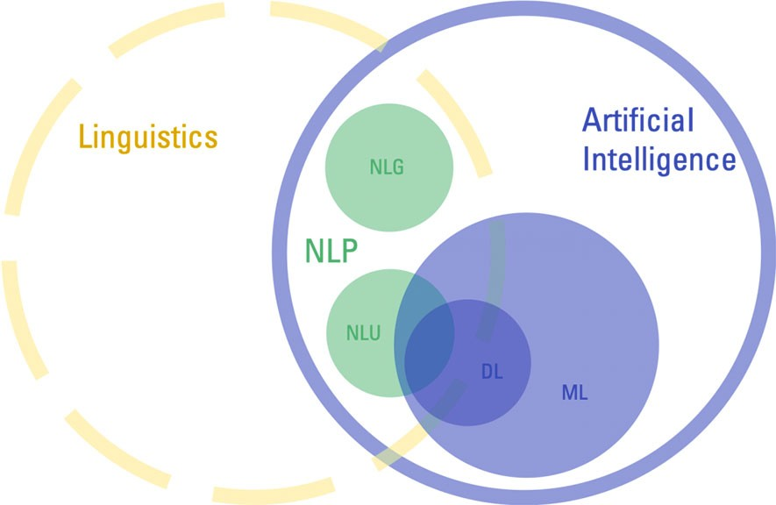
Bird's-eye View

Slide 6
Examples
Rule-based
Chatbots
Text Summarization

Slide 7



NLP Tasks
NLP
NLU
NLG
Natural Language Processing
Natural Language Generating
Natural Language Understanding
Notes:
NLP Has Two Main Tasks:

Slide 8
Natural Language Understanding (NLU)
A subset of NLP, which uses syntactic and semantic analysis of text and speech to determine the meaning of a sentence.
Syntax: The grammatical structure of a sentence.
Semantics: Focuses on the meaning of words and sentences.
NLU focuses on computer reading comprehension
Notes:
Ability of machine to understand human language

Slide 9
Natural Language Understanding (NLU)
For Example this sentence :
"Green ideas sleep furiously.“
Syntax : Its correct as it follows the basic structure of subject-verb-object.
Semantics: It doesn't make any sense because the meanings of the words don't create a logical concept.

Slide 10
Natural Language Understanding (NLU)
Another example :
1. Alice is swimming against the current.
2. The current version of the report is in the folder.
Words can have multiple meanings .
NLU make it possible to understand the intended meaning depending on the context .

Slide 11

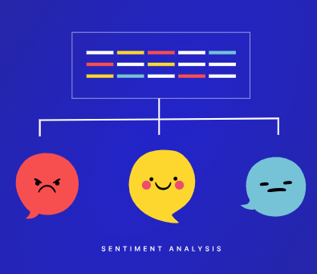
NLU Use Cases
Spam Detection
Sentiment Analysis

Slide 12
Natural Language Generating (NLG)
NLG is the ability of a computer program to generate human-like text.
NLG systems take data as input, which can be structured or unstructured, and use it to create natural language outputs.
NLU May be an initial step for NLG

Slide 13

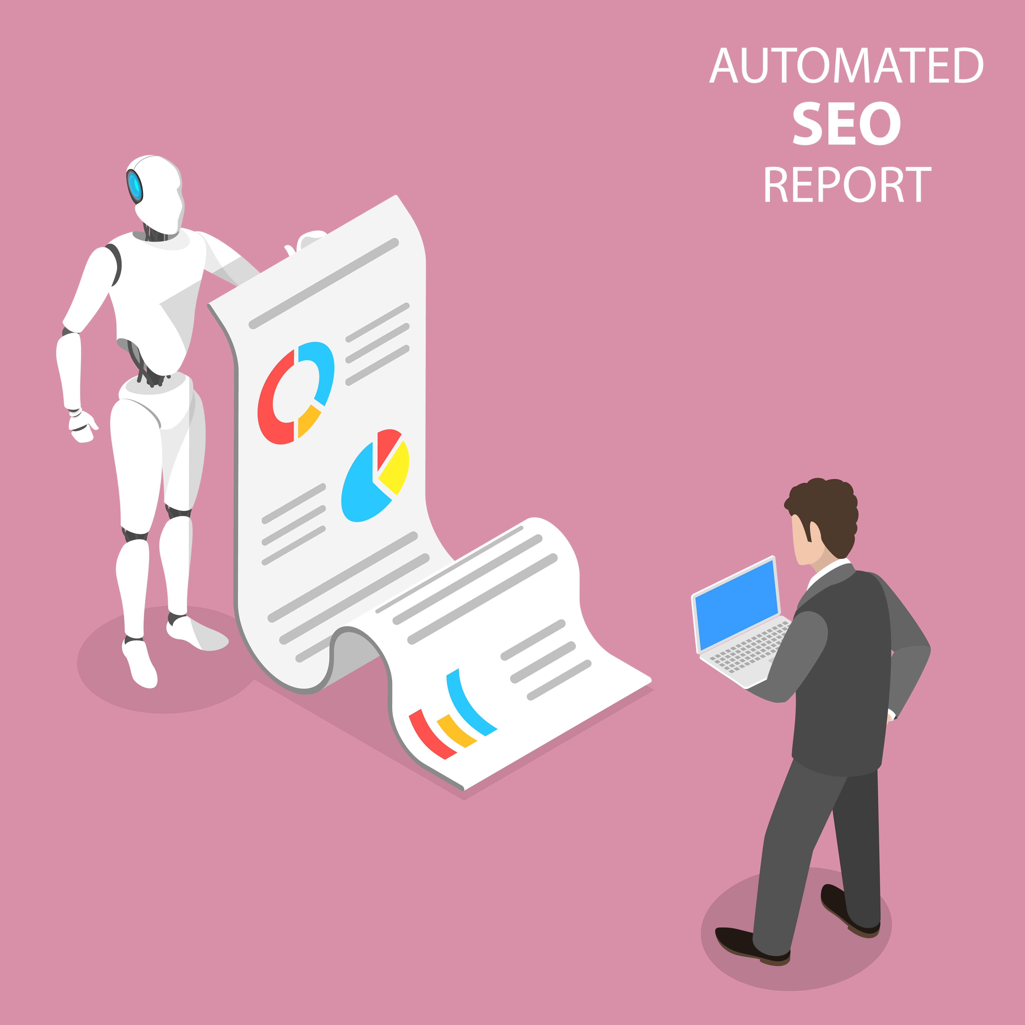
NLG Use Cases
Automated Reporting
Text Translation
Notes:
Report Generation: NLP can automate the report generation process by translating the analyzed data into clear and concise reports. These reports can include visualizations, charts, and insights tailored to user needs.

Slide 14
NLP Lifecycle
Problem Definition and Data Collection
Data Preprocessing and Feature Engineering
Model Selection and Training
Model Evaluation and Tuning
Deployment and Monitoring
Problems :
Sentiment Analysis , Text Classification, Topic Clustering ...etc.
Data :
Text / Voice
Data Cleaning
Tokenization
Stemming
Lemmatization
Spell Correction
RNNs
BERT
GPT
ALBERT

Slide 15






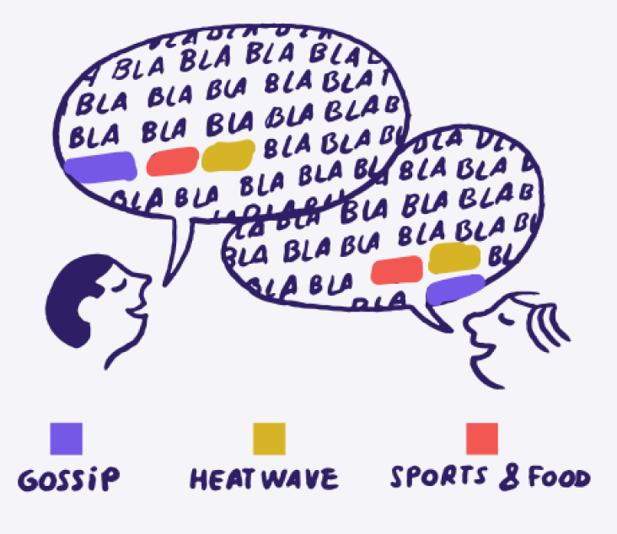





Common NLP Problems
Machine Translation
Speech Recognition
Text Summarization
Question Answering
Text Classification
Sentiment Analysis
INFORMATION RETRIEVAL
Chatbots and Virtual Assistants
Text Similarity
Topic Modeling
Notes:
Topic modeling is more about uncovering hidden themes, while topic clustering focuses on document organization.
Topic modeling provides a probabilistic view of topics, while topic clustering offers a more categorical grouping.

Slide 16
Text Preprocessing

Slide 17
Text Preprocessing Steps
Stemming
Lemmatization
Spell Checking And Correction
Text Preprocessing
Tokenization
Stop Words
Handling Numerical Data
Lowercasing
POS tagging
Named Entity Recognition
Normalization
Chunking

Slide 18
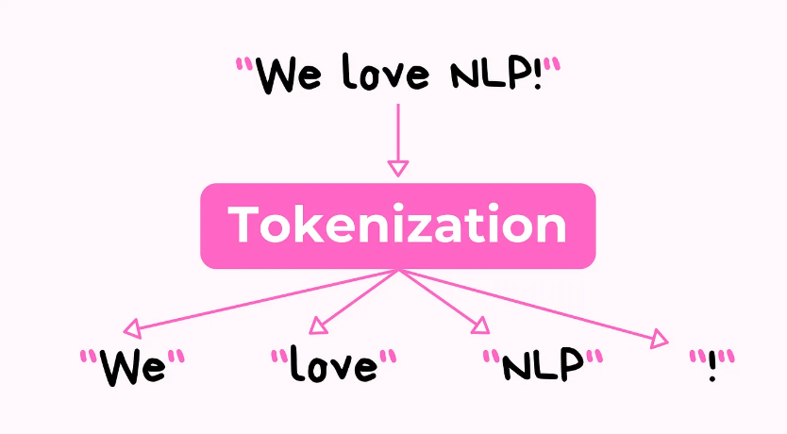
Tokenization
The process of breaking down a text into individual units called tokens.
A token is a word, a phrase, a character or other meaningful elements.
[“We”, “love”, “NLP” ,”!”]

Slide 19
Tokenization
The primary goal of tokenization:
To represent text in a manner that's meaningful for machines without losing its context.
Types of Tokenization
Sentence Tokenization
Word Tokenization
WordPiece Tokenization
Subword Tokenization
"I love natural language processing. It's fascinating!“
["I love natural language processing." ,"It's fascinating!"]
"Natural language processing”
["Natural", "language", "processing”]
"unhappiness“
["un", "happiness"]
"unhappiness“
["un", "hap", "pi", "ness"]

Slide 20
Tokenization
Challenges :
Dealing with punctuation that could be part of a token or separate tokens. ( “U.K.”)
Handling exceptional cases: like dates, amounts, and abbreviations.
Splitting compound words. Breakfast
Adjusting to the context, the same sequence of characters might need to be tokenized differently depending on its use.

Slide 21
Normalization
The process of transforming text into a standard, consistent format to enhance its analysis, understanding, and processing.
It helps reduce variability, noise, and redundancy in the text corpus.
Stemming
Lemmatization
Stop Words
Handling Numerical Data
Lowercasing
Normalization
Notes:
Data cleaning

Slide 22

Stop Words
Stop words are commonly occurring words in a language that do not carry significant meaning or contribute to the understanding of the text.
They are typically removed to improve the efficiency and accuracy.

Slide 23
Stemming
Stemming is a technique used to simplifies a word to its stem (base or root) by removing the suffixes or prefixes from words
It helps in enhancing text analysis and language understanding.
Importance of stemming :
Normalization
Vocabulary Reduction
Improving Information Retrieval
program
programming
programs
programmer
Notes:
Normalization: Stemming normalizes words by reducing them to their base form, improving consistency in text processing.
Vocabulary Reduction: By reducing inflected words to their stems, stemming reduces the vocabulary size, simplifying text analysis and model training.
Improving Information Retrieval: Stemming enhances information retrieval systems by treating variant forms of words as the same, leading to more accurate search results.

Slide 24
Stemming
Challenges:
Under-stemming
can’t get the root of did as do
Over-stemming
universe → univers
Language challenges
For example, an Italian stemmer is more complicated than an English stemmer because there is a higher number of verb inflections.
Notes:
Normalization: Stemming normalizes words by reducing them to their base form, improving consistency in text processing.
Vocabulary Reduction: By reducing inflected words to their stems, stemming reduces the vocabulary size, simplifying text analysis and model training.
Improving Information Retrieval: Stemming enhances information retrieval systems by treating variant forms of words as the same, leading to more accurate search results.

Slide 25
Lemmatization
A technique used to reduce inflected words to their root word by identifying an inflected word’s “lemma” (dictionary form) based on its intended meaning and context.
It ensures that the resulting lemma is a valid word in the language.
Programming
Program
Better
Good
Mice
Mouse

Slide 26


Lemmatization
Characteristics of Lemmatization
Accuracy:
Unlike stemming ,it does not merely cut words off.
Analysis of words is conducted based on the word’s POS (Part-of-Speech) to take context into consideration.
It leads to real dictionary words being produced.
Time-consuming:
Compared to stemming, lemmatization is a slow .
This is because lemmatization involves performing morphological analysis and deriving the meaning of words from a dictionary.

Slide 27
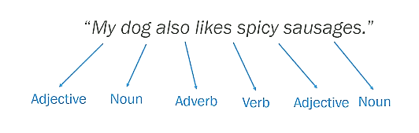
Part-of-Speech Tagging
An NLP task where the goal is to assign a grammatical category (such as noun, verb, adjective, etc.) to each word in a given text.
This provides a deeper understanding of the structure and function of each word in a sentence.

Slide 28
Text Representation

Slide 29
Text Representation (Vectorization)
A preprocessing step that aims to converting raw text data into a format that computers can understand and work with.
Common techniques for text representation:
Bag-of-Words
TF-IDF
N-grams
Word Embeddings

Slide 30
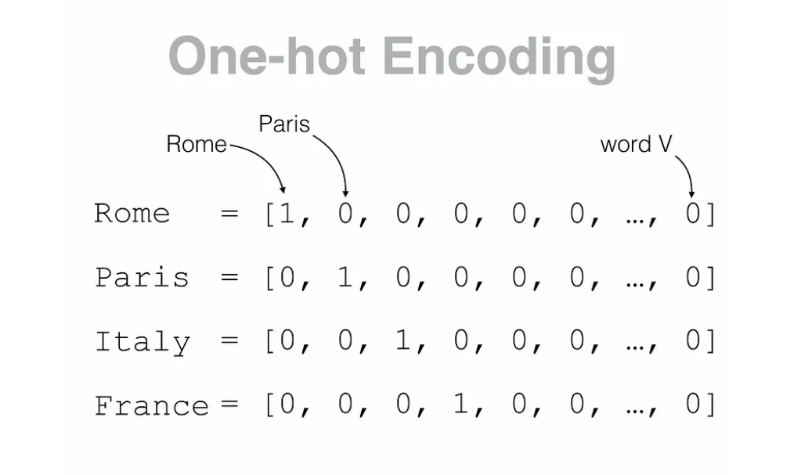
One-hot Encoding
This does not provide much information about word meaning and it does not reveal any existing relationship between words.

Slide 31
Bag-of-Words (BoW)

Slide 32
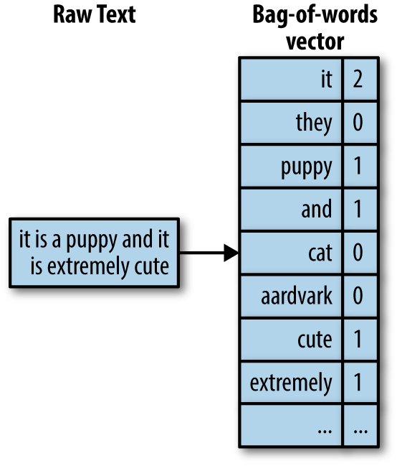
Bag-of-Words (BoW)
The Bag-of-Words (BoW) model is a simplified approach to representing text data.
It simplifies the text by representing it as a numerical vector. It focuses on word frequency rather than word order
The complexity of BoW depends on the tokenization level.
Notes:
It is called a “bag” of words, because any information about the order or structure of words in the document is discarded. The model is only concerned with whether known words occur in the document, not where in the document
A very common feature extraction procedures for sentences and documents is the bag-of-words approach (BOW). In this approach, we look at the histogram of the words within the text, i.e. considering each word count as a feature..

Slide 33
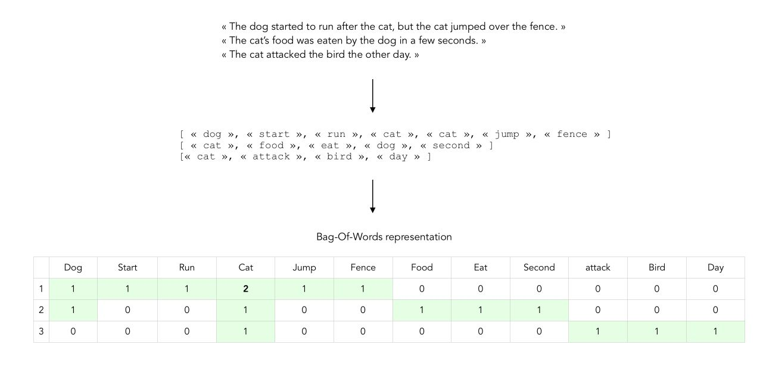
BoW Sentence Similarity Example
Lowercasing
Stemming
Lemmatization
Stop Words

Slide 34
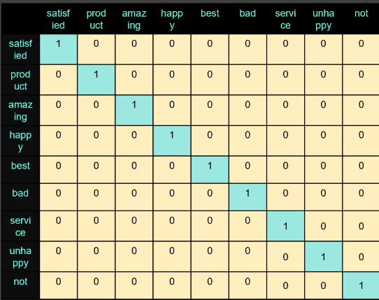
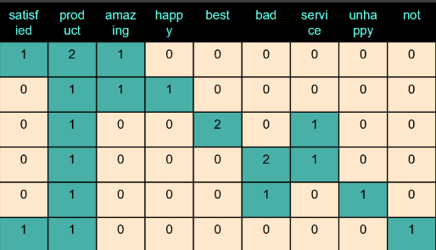
How does BOW work?
1. It uses One-hot encoding method to generate a feature vector for each unique word
1. Then generate a sentence feature vector by summing the words vectors that this sentence include

Slide 35
TF-IDF

Slide 36
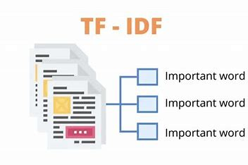
Term Frequency-Inverse Document Frequency (TF-IDF)
A statistical measure that evaluates how relevant a word is to a document in a collection of documents.
Term Frequency (TF): is a measure
of how frequently a term appears in
a document
Inverse Document Frequency (IDF) :
is a measure of how important a term is.

Slide 37
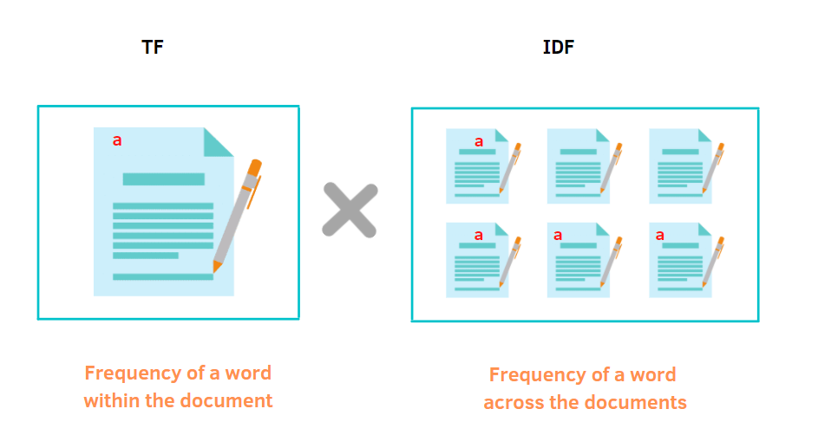
Term Frequency-Inverse Document Frequency (TF-IDF)

Slide 38
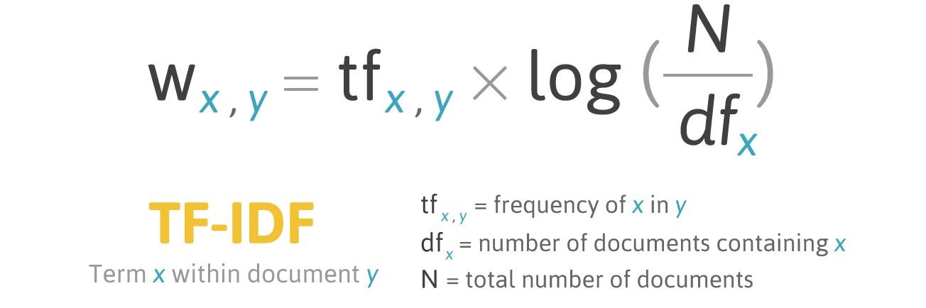
Term Frequency-Inverse Document Frequency (TF-IDF)

Slide 39
BoW Vs TF-IDF
BOW
TF-IDF
Both
Assigns equal importance to all words.
Gives higher weight to rare words
Both methods ignore word order and context, resulting in a loss of semantic information.

Slide 40
Word Embedding

Slide 41
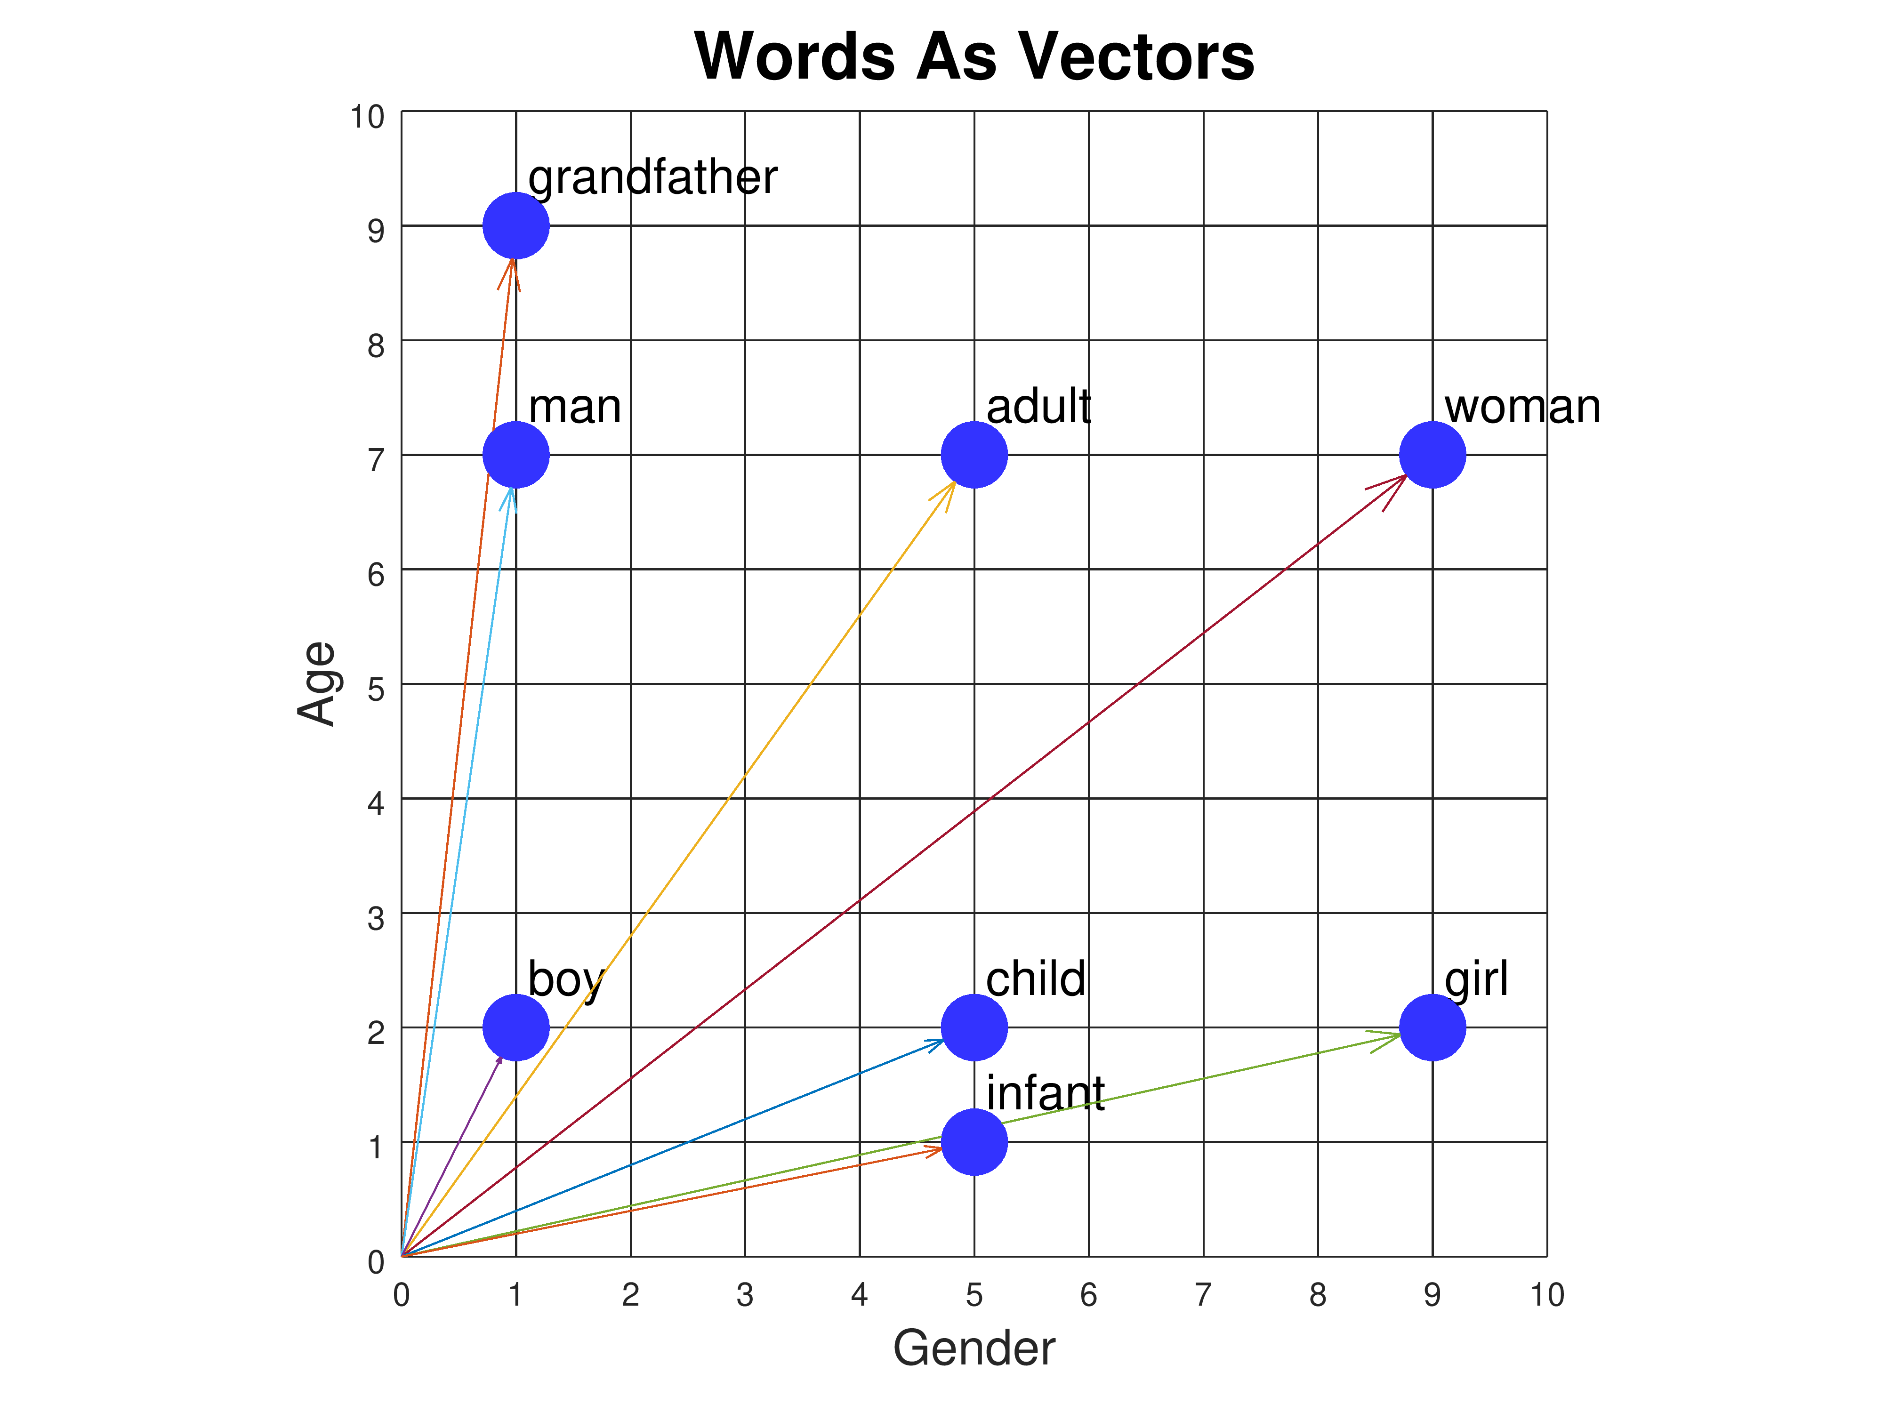
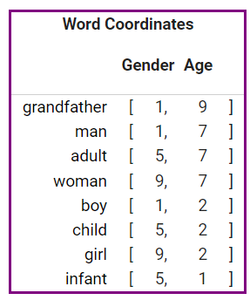
Word Embedding
A type of word representation where every term in the corpus is represented by a numerical vector.
It allows words with similar meanings to have a similar representation.

Slide 42
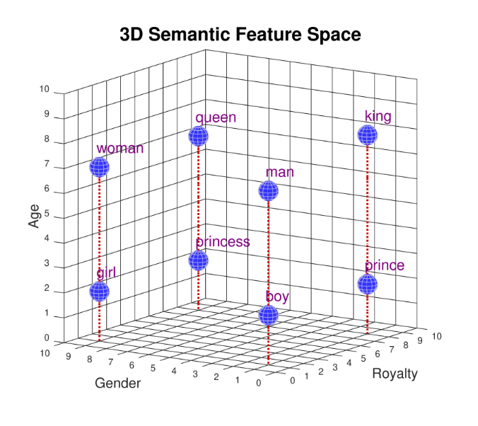
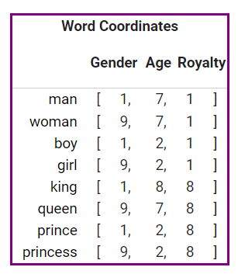
Word Embedding
3 Dimensions vector representation

Slide 43
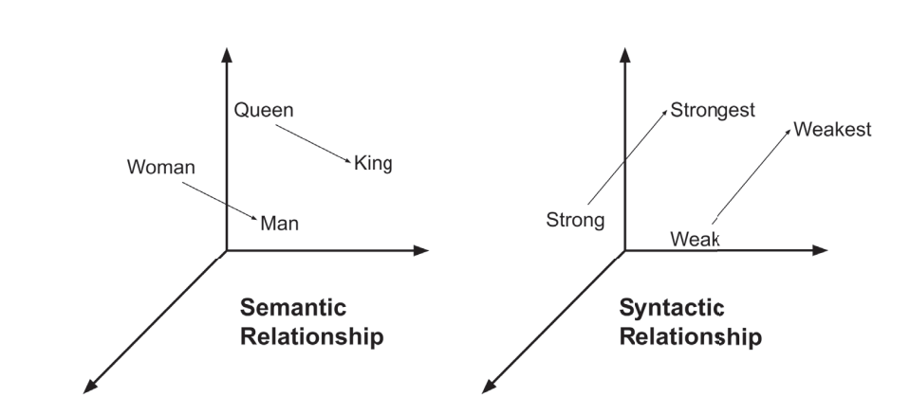
Word Embedding
word embeddings can capture both semantic and syntactic relationships between words.
Man – King + Women -> A vector that’s similar to queen

Slide 44
Why Do We Use Word Embedding Instead of TF-IDF and BOW?
Loss of semantic information:
Both BOW and TF-IDF focus on frequency and ignore word order and context .
Eliminating the sparse representation:
The resulting vectors in BOW and TF-IDF techniques are sparse( have a lot of 0’s) ,which is bad to memory and algorithm.

Slide 45
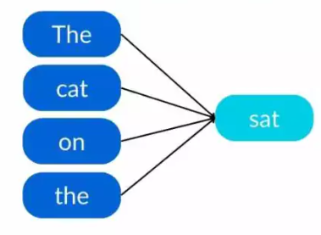
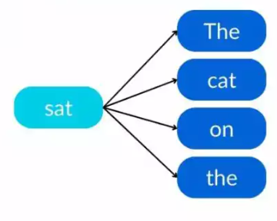
Word Embedding
Word Embedding Approaches
CBOW
Continuous Bag-of-Words
Skip-grams

Slide 46
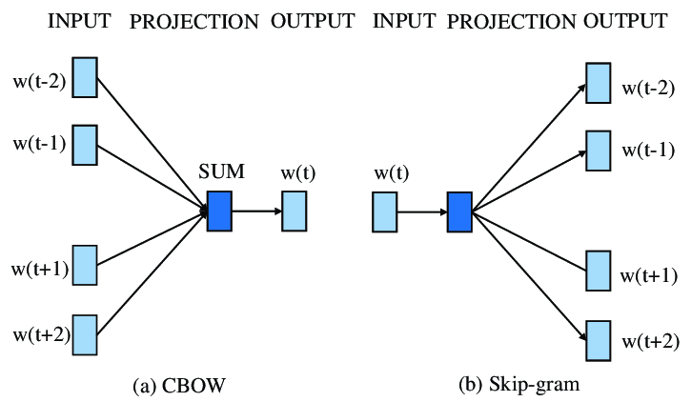
CBOW
In CBOW approach, the neural network model will try to predict the center word given context words.

Slide 47
Skip-gram
It aims to predict surrounding context words based on a given target word.

Slide 48
CBOW Vs Skip-grams
 | CBOW | Skip-grams
Convergence Time | Hours | Days
Learning Relationships Between Words | Better at syntactic relationships | Better at understanding the semantic relationships.
Sensitivity to Overfitting Frequent Words | High | Less
Amount of Documents Required | More | Less
Notes:
CBOW is prone to overfit frequent words because they can appear several times in the same set of context words.
TLDR: Skip-gram works better when working with a small amount of data, focuses on semantic similarity of words, and represents rare words well.
On the other hand, CBOW is faster, focuses more on the morphological similarity of words, and needs more data to achieve similar performance.

Slide 49
Important NLP libraries
Scikit-learn: Machine learning in Python.
Natural Language Toolkit (NLTK): The complete toolkit for all NLP techniques.
Pattern – A web mining module for the with tools for NLP and machine learning.
TextBlob – Easy to use nlp tools API, built on top of NLTK and Pattern.
spaCy – Industrial strength N LP wit Python and Cython.
Gensim – Topic Modelling for Humans
Stanford Core NLP – NLP services and packages by Stanford NLP Group.

Slide 50
Thanks
Tamara Abu-hawele
Please keep this slide for attribution

